Slide 1
The british flag
Made by David, Bart and Stef

Slide 2
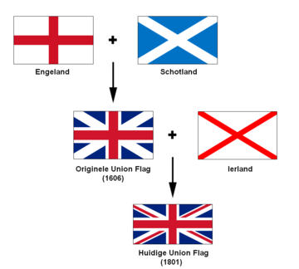
north

Slide 3
The Union Flag is shown on Government buildings on:
- Days marking the birthdays of members of the Royal Family
- Commonwealth Day
- Coronation Day
- The Queen's official birthday
- Remembrance Day
- On the days of the State Opening and prorogation of Parliament

Slide 4
Facts
- Did you know the british flag is actually called The Union Jack
- The actual background, or field, is blue
- The colors on the British flag represent the following:
White - peace and honesty
Red - hardiness, bravery, strength & valour
Blue - vigilance, truth and loyalty, perseverance & justice
Questions
1. What is the nickname of the flag of the United Kingdom?
2. What colors are in this flag?
3. The flags of what countries are represented in this flag?
4. When was this flag first used?
The Union Jack
White-Red-Blue
England-Scotland-North Ireland
1801

Slide 5
Sources and questions
http://www.royal.gov.uk/MonarchUK/Symbols/UnionJack.aspx
http://nl.wikipedia.org/wiki/Vlag_van_het_Verenigd_Koninkrijk
http://www.vexillologymatters.org/british-flag.htm

